Slide 1
My Health LA LA County Department of Health Services Final Community Partner Webinar October 26, 2023

Slide 2
Announcements
Thank you for coming today!
We will take questions at the end. Feel free to type questions in the chat.
We will post the slides and recording on the MHLA website.
Notes:
Thank you to everyone – this is our second and final webinar on the sunsetting of the program. We will mute everyone and will take questions at the end.

Slide 3
Sunsetting of My Health LA
General Overview
Notes:
A LOT OF INFO HERE – specialty care at the end – but get through other things first.

Slide 4
Sunsetting Overview
Program ends January 31, 2024.
Everyone will be disenrolled that day.
Several new clinic sites added over the past several months – thanks for meeting the deadlines!
No more new sites can be added to the MHLA contracts.
Notes:
As you all know by now – the governor and legislature have extended full-scope Medi-Cal to all undocumented immigrants as of Jan. 1 2024. We are allowing a one-month grace period. In our previous webinar we presented several deadlines and we appreciate you all for meeting them. One of those was re: new sites. I think we were able to accommodate all the CPs.

Slide 5
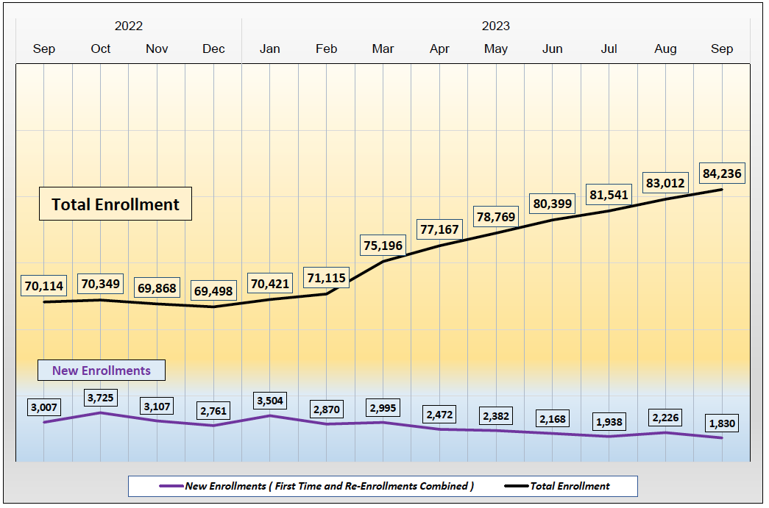
MHLA Enrollment Trend
Reports - My Health LA (lacounty.gov)
Notes:
Quick overview on enrollment. Numbers are climbing. New enrollments have dropped some. The numbers reflect the change we made when we stopped disenrolling participants who didn’t renew in time. What this means for you is that you have a lot of folks to get onto Restricted Medi-Cal!

Slide 6
Leases
Some Community Partner clinics have been receiving lease space at no cost.
DHS/LA County will no longer cover the cost of those leases after the end of the program.
Until the leases expire, however, DHS will continue to work with CPs on repairs.
Some of the leases expire in 2024, others later.
Notes:
If we haven’t been in touch with you – we will asap.

Slide 7
Sunsetting of My Health LA
Communications

Slide 8
Communications
MHLA sent out texts, robocalls, letters and flyers to all enrolled Program Participants this year.
We are also working with DPSS, Office of Immigrant Affairs and DPH to get the word out.
DHCS’ October letter sent to everyone on Restricted Medi-Cal announcing the expansion to Full Scope and the My Medi-Cal Choice packet coming in the mail.
DHCS' December letter announcing final transition details to everyone on Restricted Medi-Cal.
Notes:
We have been on a stakeholder committee working with DHCS on the transition, reviewing materials and raising concerns. MHLA participants should be getting letters soon if they haven’t already – be ready to help them choose their plan and provider so they can stay with you.

Slide 9
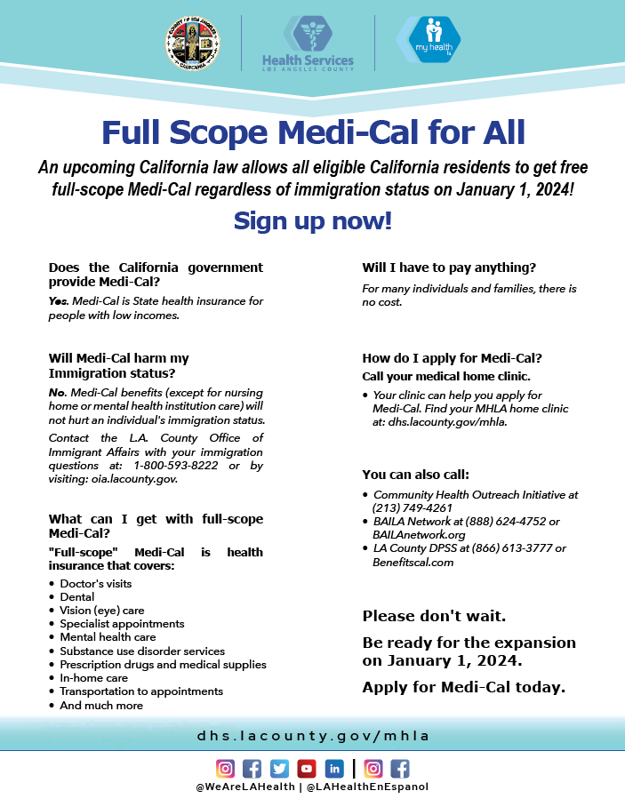
Flyers
Available in:
English
Spanish
Armenian
Simplified Chinese
Farsi
Korean
Russian
Tagalog
Thai
Vietnamese
Available on our website

Slide 10
Communications
For in-person assistance, Health Enrollment Navigators are available. Visit: GetMedi-CalCoverage.dhcs.ca.gov and select “Find Local Help.”
Additionally, DHCS developed the Global Outreach Language Toolkit to foster collaboration with community organizations.
The Get Your Community Covered Resource Hub offers a wide range of outreach materials in all threshold languages.
Find these and additional resources on the DHCS website: Adult-Expansion (ca.gov)
Notes:
DHCS is offering much more assistance than previously. They have provided funding for navigators, they are investing in a communications campaign;. Some of this will continue into 2024 to capture folks who are not enrolled.

Slide 11
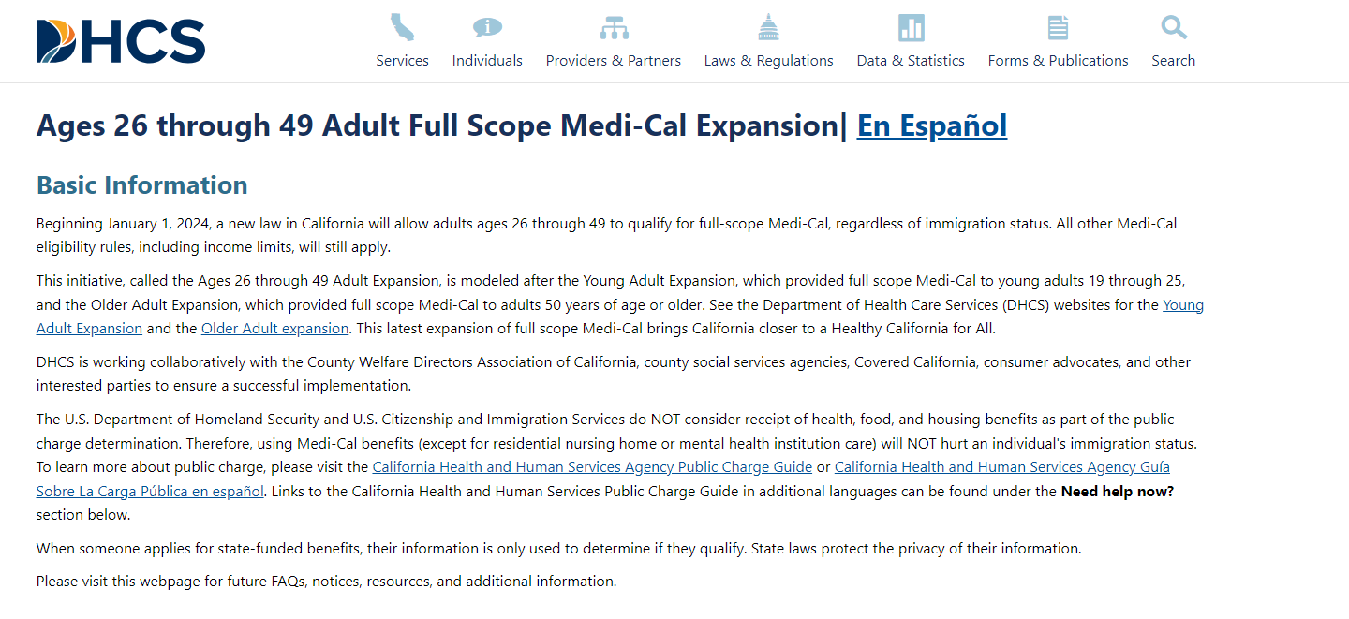
Communications
Notes:
Website - in English and Spanish. Talks about public charge – and the privacy of the information used for enrollment.

Slide 12
Sunsetting of My Health LA
MHLA Eligibility Review Unit (ERU)

Slide 13
ERU
The Eligibility and Enrollment Review monthly audits will cease December 31, 2023.
One-e-App accounts are converting to “Read Only” on January 1, 2024.
CPs can continue to view accounts in OEA through March 31, 2024.
Notes:
We do regular audits to make sure everyone who is in MHLA should be. Those are continuing now but we will stop at the end of the year. Even as you enroll, make sure you continue to check documents and enroll only people who are eligible. You also will only have read only access so you won’t be able to enroll anyone after the new year.

Slide 14
Sunsetting of My Health LA
MHLA Dental Services
Notes:
OK I am going to run through a few slides about upcoming deadlines on dental, pharmacy and other services.

Slide 15
Dental
All dental billing must be submitted by March 31, 2024.
No exceptions will be allowed.
Final payments to CPs will be made shortly thereafter.
Notes:
We currently allow dental claims for 60 days. That will be the same for the end of the program. So please get everything in in a timely way. We occasionally have made exceptions but we won’t be able to do that with this last round of services.

Slide 16
Sunsetting of My Health LA
MHLA Pharmacy Services

Slide 17
MHLA Pharmacy Services
Last day for MHLA participants to fill any prescriptions, including refills, is January 31, 2024.
CPs should reach out to their program participants to ensure they have three months of their prescriptions to carry them over until they are settled into their new Managed Care Plan (MCP).
DHS Central Fill will cease providing MHLA services on January 31, 2024.
Notes:
Individuals will not be able to get medications after the end of the program. So if you are seeing a patient on Jan. 27, make sure they go right away to get their medication – and that you consider longer (60 or 90 instead of 30, for example) prescriptions.

Slide 18
MHLA Pharmacy Services
MHLA is asking CPs to notify pharmacies/dispensaries to submit any reversals on or before March 31, 2024.
For pharmacy claims processing questions, please contact Ventegra’s Customer Care Team (CCT) at 855-444-7757.
The CCT line will remain operational through March 31, 2024.
MHLA encourages the CPs to actively assist the Program Participants in transitioning to their new Managed Care Plan pharmacy.
Notes:
Please work with your pharmacies and dispensaries on any reversals. The Ventegra call line will remain open until March 31. Please please work with your MHLA participants so they know where to go for medications after the end of MHLA. We don’t want ANYONE to be impacted by this transition or be turned away and not know where to go.

Slide 19
Sunsetting of My Health LA
MHLA Mental Health Prevention Services

Slide 20
Mental Health Prevention Services
Note that all CPs that have opted in for MHPS are required to submit Discharge Reports by the 15th of the month following the month of service.
All MHPS Discharge Reports must be submitted by February 15, 2024.
There will be no exceptions or late submissions allowed.
Notes:
As for our partnership with DMH, that is coming to an end as well. Submit the discharge reports by Feb. 15! Materials that you all have been using =- please feel free to continue using them. The website will stay live for a while after the end of the program.

Slide 21
Sunsetting of My Health LA
MHLA Substance Use Disorder Services/Substance Abuse Prevention and Control (SAPC)

Slide 22
Substance Use Disorder Services
Please work with your contacts (the SAPC contractor) if you have MHLA program participants enrolled in any of these services to explore further options for your agency.
Call the Substance Abuse Services Helpline (SASH) 1-844-804-7500 to refer patients directly to SUD treatment
Go to the Service and Bed Availability Tool (SBAT), Los Angeles County’s provider directory https://sapccis.ph.lacounty.gov/sbat/
Visit the SAPC webpage for other entryways at: http://publichealth.lacounty.gov/sapc/public/entryways-to-treatment.htm?tm
Notes:
SAPC provides services for uninsured and Medi-Cal. Please have your participants in treatment to tell their SAPC provider about the change in coverage. If you have new participants who need services, continue to refer to SAPC. They are available for your participants – and provide a range of services from detox to medication for assisted treatment to residential.

Slide 23
Substance Use Disorder Services
These resources are available on the SAPC website:
Notes:
ANNA

Slide 24
Sunsetting of My Health LA
MHLA Final Billing Process

Slide 25
Final Billing Processes
Final MGF billing to be submitted by March 31, 2024, no exceptions.
Final MGF payments to be made to all CPs by April 30, 2024.
Notes:
We will use the enrollment as of Jan. 31 and the claims submitted by March 31 to determine if the participants had a qualifying visit in the previous 24 months. You should get your last payments by end of April.

Slide 26
Sunsetting of My Health LA
MHLA Member Services

Slide 27
MHLA Member Services
After January 31, 2024 or shortly thereafter, MHLA Member Services Line (844-744-6452) will redirect callers to a voice mail message:
Will refer the caller back to their CP clinic for general inquiry
Will refer the caller to the Specialty Care Linkage (SCL) line for specialty service inquiries
Will refer the caller to DPSS for Medi-Cal inquiries
For eConsult questions, please call the Enterprise Help Desk: (323) 409-8000
Notes:
. If participants call the member services line – they will get a message referring them where to call.

Slide 28
MHLA Member Services
Most MHLA staff will be moving on to new roles at DHS.
As of now, two MHLA senior program managers will be available through March 2024 for any urgent final questions:
Philip Barragan: pbarragan@dhs.lacounty.gov
Marie Quesada: mquesada@dhs.lacounty.gov
Anna Gorman can be reached at agorman@dhs.lacounty.gov
Notes:
ANNA

Slide 29
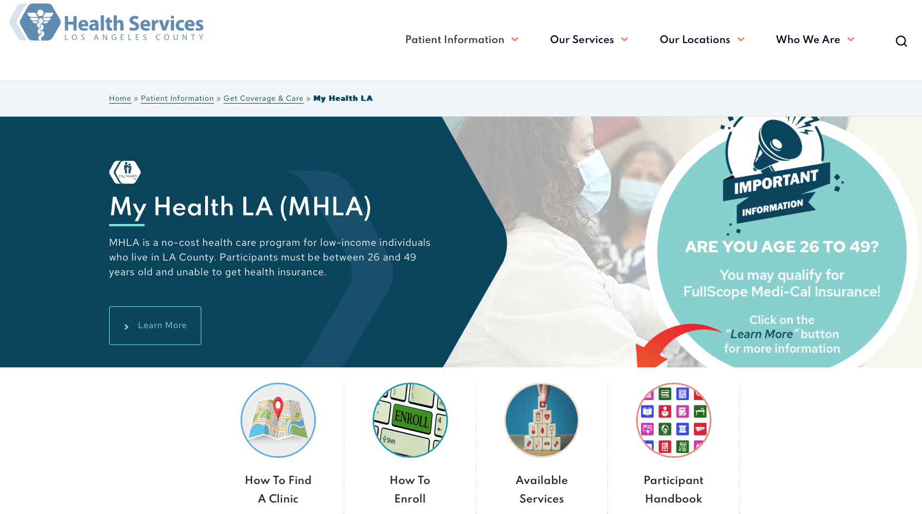
MHLA Website
Notes:
We have new information on the website – for participants, and for you all.

Slide 30
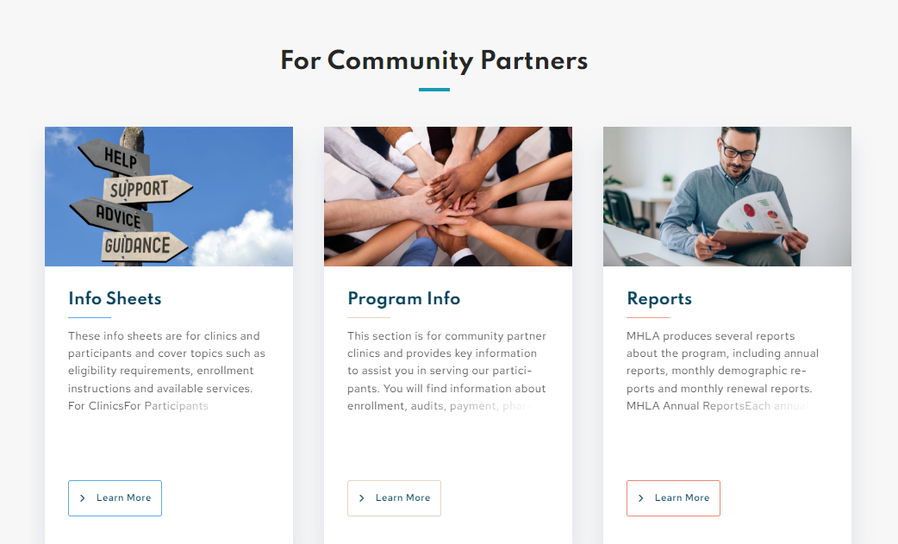
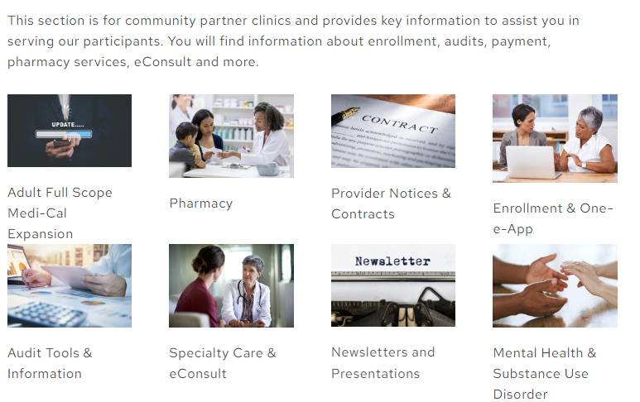
MHLA Website
The MHLA website will remain live through 2024.
Notes:
We have new information on the website – for participants, and for you all.

Slide 31
Sunsetting of My Health LA
MHLA Medi-Cal Enrollment Incentive Project Update

Slide 32
Medi-Cal Incentive Project
The goal was to encourage MHLA participant enrollment into Restricted Medi-Cal.
DHS is providing financial incentives for MHLA Community Clinic Partners based on enrollment increases.
The 6-month project period is May 1, 2023 to October 31, 2023.
Congratulations on getting so many participants enrolled into Restricted Medi-Cal! Every CP did an incredible job!
Notes:
Started in May – used some extra money in the budget allocated for quality improvement. We provided names/status in the spring and are planning to do soon. We have been impressed hearing about all the enrollment events, fairs, outreach to get folks onto restricted Medi-Cal.

Slide 33
Medi-Cal Incentive Project
MHLA Program Office will collect October MHLA data by November 15th.
We will immediately send it to DPSS for analysis to determine Medi-Cal enrollment for MHLA population.
When the results come back from DPSS, we’ll do our analysis on the data to determine which individuals have Restricted Medi-Cal.
Note that DPSS may take several weeks to run the data before MHLA gets it back.
Notes:
ANNA

Slide 34
Medi-Cal Incentive Project
MHLA Program Office plans to provide the following data for each CP:
List of all enrolled program participants who have Medi-Cal through October 2023 by CP.
List of those individuals provided at the beginning of the project to determine overall Medi-Cal enrollment percentage increase for the financial incentive.
Data will be "editable" for utilization by CPs.
Our goal is to get the financial incentive payments to all CPs by January 31, 2024.
Notes:
ANNA

Slide 35
Sunsetting of My Health LA
Specialty Care & eConsult Post MHLA
Notes:
Ok this is the area where I know there are the most concerns and questions. Two points first: 1. We want to ensure a smooth transition. 2. DHS continues to be the safety net for uninsured, low-income patients. REISSUING Provider Bulletin with a few updates

Slide 36
Specialty Care
CPs can submit eConsults for individuals who are uninsured, ineligible for Medi-Cal and low-income after January 31, 2024.
Do not send eConsults for full-scope Medi-Cal eligible or enrolled individuals.
Notes:
ANNA

Slide 37
Specialty Care
CPs must check insurance status before submitting eConsults.
Anyone coming to DHS will be financially screened for eligibility and payer source. (Details on the following slides.)
If seen, patients may have to pay for a portion of their care, depending on income and eligibility for County’s low-cost assistance programs.
DHS continues to be a 'safety net health system' for LA County and will continue to be here as a partner and provider.
Notes:
Please check insurance status – however you do that now, please continue to do so. If you don’t – it will impact patients.

Slide 38
eConsult
Starting February 1, 2024
Uninsured and Medi-Cal Eligible | May have their appointment cancelled. If Medi-Cal eligible, patients may be given the option to switch to DHS for primary/specialty and referred for Medi-Cal enrollment.
Medi-Cal FFS | Will be scheduled for the visit. Note: DHS recommends CPs review urgency of eConsults and look toward establishing care in MCP network.
Notes:
ANNA

Slide 39
eConsult
Starting February 1, 2024
Full Scope Medi-Cal and Enrolled in a Non-DHS MCP | DHS will either: Encourage them to establish care in their new plan network and cancel the visit or Offer them the opportunity to switch to DHS for primary care so they can get both primary care and specialty care together at DHS and schedule the visit. The patient or the PCP may submit a Continuity of Care (COC) request to the health plan to maintain specialty care at DHS.
Notes:
ANNA

Slide 40
eConsult
Starting February 1, 2024
Medi-Cal Ineligible/Over 138% FPL | Will be scheduled for the visit and screened by DHS Financial Services to determine what County No Cost/Low-Cost Programs, (e.g., Ability to Pay, Discounted Payments) are appropriate.
Notes:
ANNA

Slide 41
eConsult – Safety Net Connect
DHS will continue paying for eConsult access until August 31, 2024. CPs will need a BAA directly with Safety Net Connect.
After that date, the clinics will likely need contracts with Safety Net Connect and will have to pay for the service (if that option is available).
More info to come.
Notes:
ANNA

Slide 42
DHCS Webinar Upcoming
DHCS will be holding a second webinar.
Registration information will be posted on their webpage in the next week or so.
Agenda: Ages 26-49 Adult Expansion
Monday, Dec. 4 at 11 a.m.
Register: https://dhcs.webex.com/weblink/register/r00e53495c5d9f216d0c3c85172ff5300
Notes:
Some of you went to the first DHCS webinar – they went through a lot of helpful information on timing and communications. I anticipate more of that in the webinar after Thanksgiving.

Slide 43
Sunsetting of My Health LA
Thank you to our MHLA Vendors!

Slide 44
Thank you to our Vendors/Contractors!
The MHLA team wishes to thank our incredible vendors for their commitment and compassion in serving this most vulnerable population with professionalism and grace.
Ventegra
One-e-App/One Degree
American Insurance Administrators
Notes:
ANNA

Slide 45
Thank you, all, from MHLA!
Notes:
We recently celebrated MHLA, and the staff received certificates from DHS Director Dr. Ghaly. We are so thrilled for MHLA participants and grateful to all of you! This was a program that had roots in PPP and then moved to Healthy Way LA and then turned into MHLA in 2014. It became a model for other states – and had an impact on hundreds of thousands of individuals who would not have otherwise had health coverage. We all did it together and we are so proud!

Slide 46
Thank you, all, for making MHLA a success for the past ten years!
myhealthla@dhs.lacounty.gov
Main number: 626-525-5789
Anna Gorman: agorman@dhs.lacounty.gov
Philip Barragan: pbarragan@dhs.lacounty.gov
Marie Quesada: mquesada@dhs.lacounty.gov

