Slide 1
My Health LA LA County Department of Health Services Medi-Cal 26-49 Expansion April 18, 2023

Slide 2
Welcome
Thank you for joining!
Please mute yourself.
Feel free to type questions in the chat – and we will answer at the end.

Slide 3
Overview
Medi-Cal Expansion
Impact on MHLA
The plan/timeline
MHLA
What will happen?
Please help all MHLA participants enroll in Restricted Medi-Cal before January 1, 2024.

Slide 4
Medi-Cal Expansion for Adults 26 - 49
Takes effect January 1, 2024
California residents who are 26 to 49 years old, if otherwise eligible
Immigration status does not matter
Benefits better!
State website: Adult-Expansion (ca.gov)

Slide 5
Expansion and MHLA
Estimated 70,000 MHLA participants impacted
No longer qualify for MHLA after expansion
Will need to be enrolled into Restricted Medi-Cal
Program will sunset Jan. 31, 2024 (one month grace period)

Slide 6
Contract Changes

Slide 7
Contract Changes (Part 1)
Contract Amendment sending out May 2023 ​
MHLA program sunsetting January 31, 2024.
Encounter data submission deadline - March 31, 2024.​
CP Pharmacy dispensary & prescription claims ending January 31, 2024.
All MGF payments planned for no later than April 30, 2024.
All dental payments planned for no later than June 30, 2024.

Slide 8
Contract Changes (Part 2)
MHLA Audit Team annual program monitoring ending
June 30, 2023.
MHLA Eligibility Review Monitoring ending
December 31, 2023.
Adding clinic site deadlines:
Without FSR (from a health plan) – May 31, 2023
With FSR – September 30, 2023
No Medical Home changes after January 1, 2024.

Slide 9
Finance
Final payments will be made after the end of the program.
DMH Mental Health Prevention Services runs until the end of the program, including supplemental behavioral health payment.
There will be no more budget for MHLA after all participants are transitioned off of the program.

Slide 10
Pharmacy and Claims

Slide 11
Pharmacy Changes
Deadline to add pharmacy locations - May 31, 2023.​
Deadline for MHLA formulary additions – August 15, 2023​.
Community Partners and contracted pharmacies have up to 60 days (March 31, 2024) to submit claims after MHLA ends.
Advise participants to plan on filling prescriptions by January 31, 2024​.

Slide 12
Claims & Payment
Encounter claims to AIA by March 31, 2024.
Dental claims within the 60 days from the date of service and no later than March 31, 2024.
Mental Health Prevention Services encounter data must be submitted to MHLA no later March 31, 2024.
All final MGF payments planned before April 30, 2024.
All final dental payments planned before June 30, 2024.

Slide 13
Key Dates & Deadlines
April 30, 2023
First notices to MHLA Participants
June 30
Program Monitoring/Admin Final Review
July 31
Second notices to MHLA Participants
May 31
Deadline to add a clinic site without FSR or a pharmacy site
September 30
Deadline to add a clinic site with an FSR
October 31
Third notice to MHLA Participants
December 31
Eligibility & Enrollment Final Review
January 31, 2024
MHLA Program Sunsetting
March 31, 2024
Deadline to Submit Claims

Slide 14
Eligibility Review Unit

Slide 15
Timeline
Automatic Enrollment Extension
Last MHLA Webinar
MHLA ERU Audits
One-e-App User Accounts transitioned to “Read Only”
End of MHLA Coverage Period
February 1, 2023
July 27, 2023
December 31, 2023
January 1, 2024
January 31, 2024

Slide 16
Automatic Enrollment Extension
Due to the State of California’s final phase of Medi-Cal expansion, the MHLA program has decided to cease the requirement of any future MHLA Redeterminations.
On February 1, 2023, the MHLA program extended all program participant’s coverage end date through January 31, 2024. MHLA participants are no longer required to submit an annual renewal.
MHLA enrollers will continue to take and evaluate new and re-add applications in person and remotely using the same MHLA requirements and guidelines currently in place until December 31, 2023.

Slide 17
OeA User Accounts & SME line
One-e-App Access
One-e-App Accounts
SME Line
User accounts will remain active, however after 12/31/2023 all Certified Enrollment Counselor and CEC Supervisor roles will be modified to Read-only access.
All users will continue to be responsible for maintaining the confidentiality of their System account and password and will be fully responsible for all activities that occur with their account and password.
Effective August 31, 2023, CPs will no longer have assigned SMEs. Community Partners will be able to contact the SME line and Member Services until January 31, 2024.

Slide 18
MHLA ERU Audits, Training & OEA
The last MHLA Enrollment and Eligibility Webinar will be conducted on July 27, 2023.
The Eligibility and Enrollment Review monthly audits will cease December 31, 2023.
One-e-App will remain operational until January 31, 2024. Thereafter, you may contact the SME line for any questions pertaining to eligibility, until further notice.

Slide 19
Specialty Care

Slide 20
Specialty Care Overview
No new eConsults for non-DHS managed care patients after Jan. 1, 2024. No specialty care visits will be scheduled after MHLA disenrollment.
We will see FFS Medi-Cal patients but encourage them to talk to clinic.
Once on managed care, we will tell patients they are now in managed care and should continue specialty care through their new network.
We are not going to do a targeted outreach for high-risk patients.
If want to continue with DHS, can either switch to DHS or a 'continuity of care' request must be filed (only for care up to a year).

Slide 21
More on Specialty care categories
Insurance status | Disposition starting January 1, 2024
Uninsured | Patient will be referred to the DHS patient financial services (PFS) team for Medi-Cal enrollment and will be scheduled for the visit.
Restricted-Scope Medi-Cal/ Medi-Cal FFS | Patient will be scheduled for the visit. (Note: CPs to review urgency of eConsults and look toward establishing care in MCP network.)
Non-DHS MCP | Alert patient they are enrolled in a non-DHS MCP and encourage them to establish care in their new plan network and cancel the visit OR If patient desires, OPA will offer to switch them to a DHS MCP so they can get both primary and specialty care at DHS and schedule the visit OR If requested by patient or provider, CP may request a continuity of care (COC) request to continue specialty care at DHS (for up to 1 year period).

Slide 22
eConsult after MHLA
DHS will continue to receive eConsults on behalf of uninsured patients who do not qualify for Full-Scope Medi-Cal.
CPs will need a contract to continue using eConsult. Details coming soon.
DHS will audit eConsults submitted by CPs periodically for eligibility.

Slide 23
Messaging & Communications

Slide 24
Letters and Flyers
Flyers and letters to our participants
Total of 3 mailings planned from MHLA (in addition to State mailings for those on Restricted Medi-Cal)
Encourage participants to apply to Restricted Medi-Cal now

Slide 25
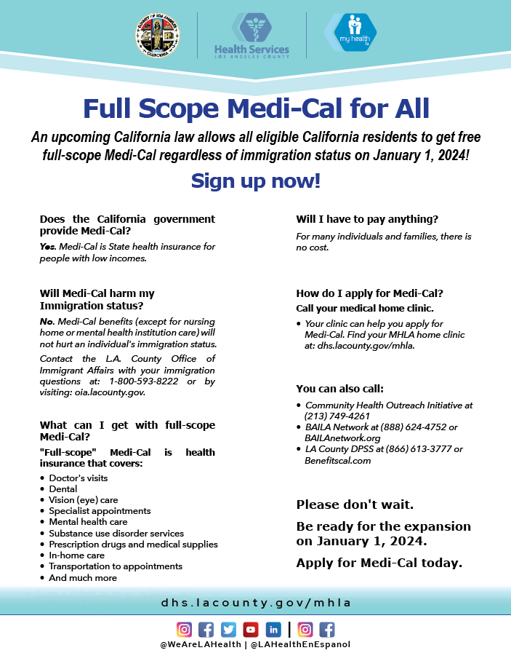
Flyers
Available in:
English
Spanish
Armenian
Simplified Chinese
Farsi
Korean
Russian
Tagalog
Thai
Vietnamese
Available on our website

Slide 26
Other Communications
Robocall and texting campaigns
Webinars – likely another in the Fall.
Webpage with information and resources
Community Council input
Robocall and Text Message
English Example
Hello #FirstName# #LastName#: My Health LA has great news to share! Beginning January 31, 2024, everyone will be eligible for Full-Scope Medi-Cal health insurance. Immigration status does not matter. You must enroll in Emergency Medi-Cal before January 31, 2024. To enroll in Emergency Medi-Cal, please contact your medical home clinic, #ClinicName# at #ClinicNumber#. You will be disenrolled from My Health LA on January 31, 2024. If you don’t know your medical home clinic, call My Health LA member services at (844)744-6452.

Slide 27
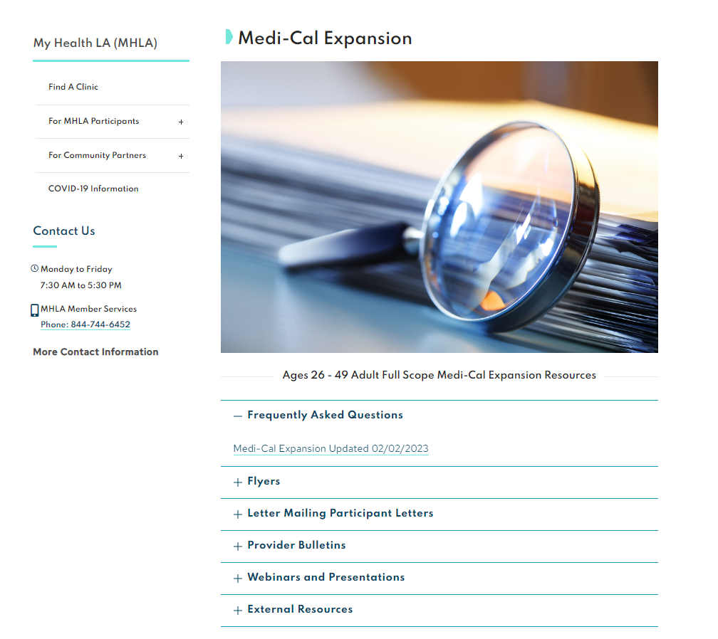
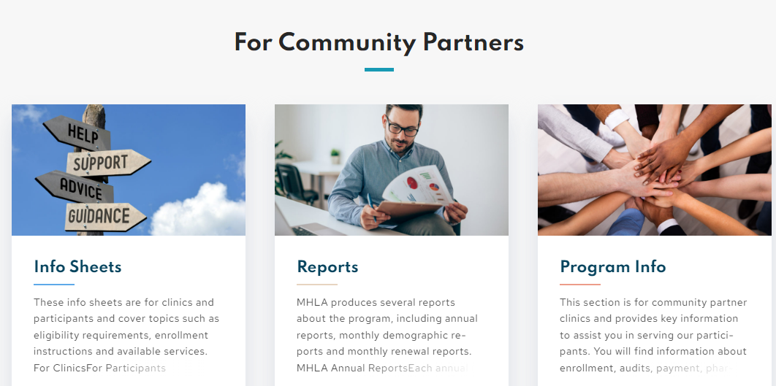
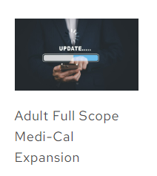
Website
Notes:
ANNA

Slide 28
What Should You Do Now?

Slide 29
Incentive Campaign
Encourage MHLA participant enrollment into Restricted Medi-Cal.
Financial incentives based on enrollment increases.
Run from April to October 2023.
Details on reward levels and incentive amounts.
Receiving data from DPSS this week.
Notes:
ANNA

Slide 30
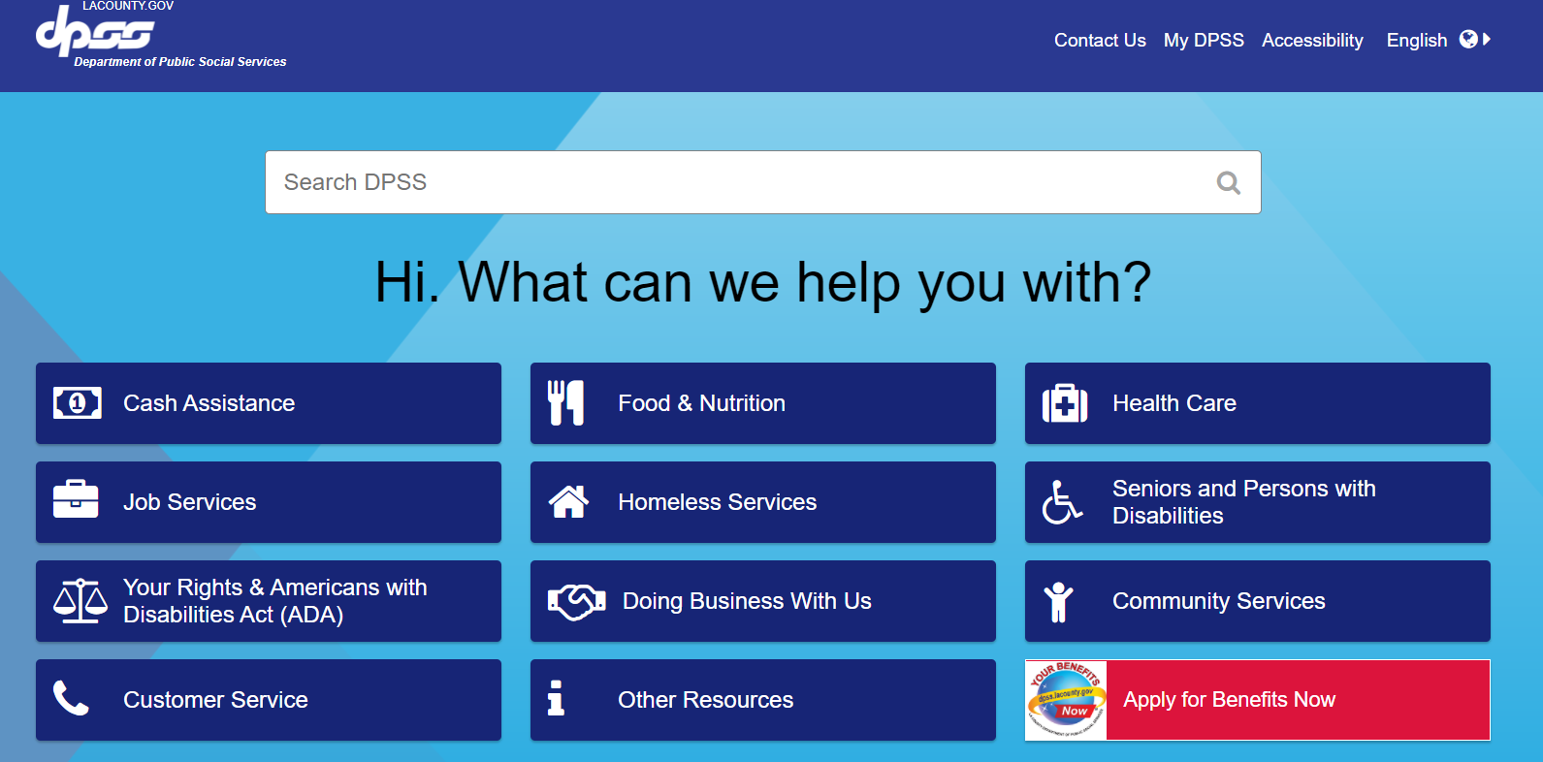
Need Help With Enrollment?
DPSS: dpss.lacounty.gov
Notes:
ANNA

Slide 31
Need Help With Enrollment?
BAILA: 888-624-4752 or www.bailanetwork.org
Community Health Outreach Initiatives
http://publichealth.lacounty.gov/mch/choi/choi.htm
Notes:
ANNA

Slide 32
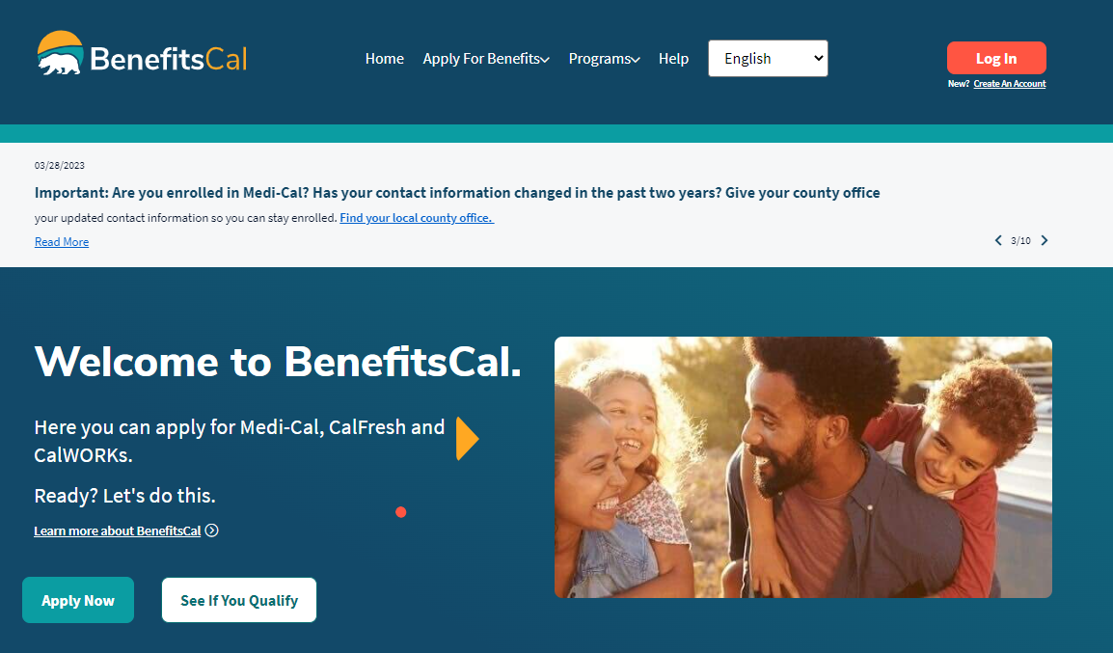
BenefitsCal
Benefitscal.com/Help/HCPDE
Notes:
ANNA

Slide 33
Public Charge
Dependency on government programs
Most are exempt from “public charge” test
Exception for long-term care
Helpful Resources:
LAC Office of Immigrant Affairs: 800-593-8222 or oia.lacounty.gov/publiccharge
BAILA: 888-624-4752 or www.bailanetwork.org
Neighborhood Legal Services of LA County: 800-433-6251 or nlsla.org

Slide 34
Thank you!

